Slide 1
Adding an update to an existing trial on HemOnc.org
This tutorial was created using the Chrome browser (109.0.5414.119) on macOS Ventura 13.2.1
February 18, 2023

Slide 2
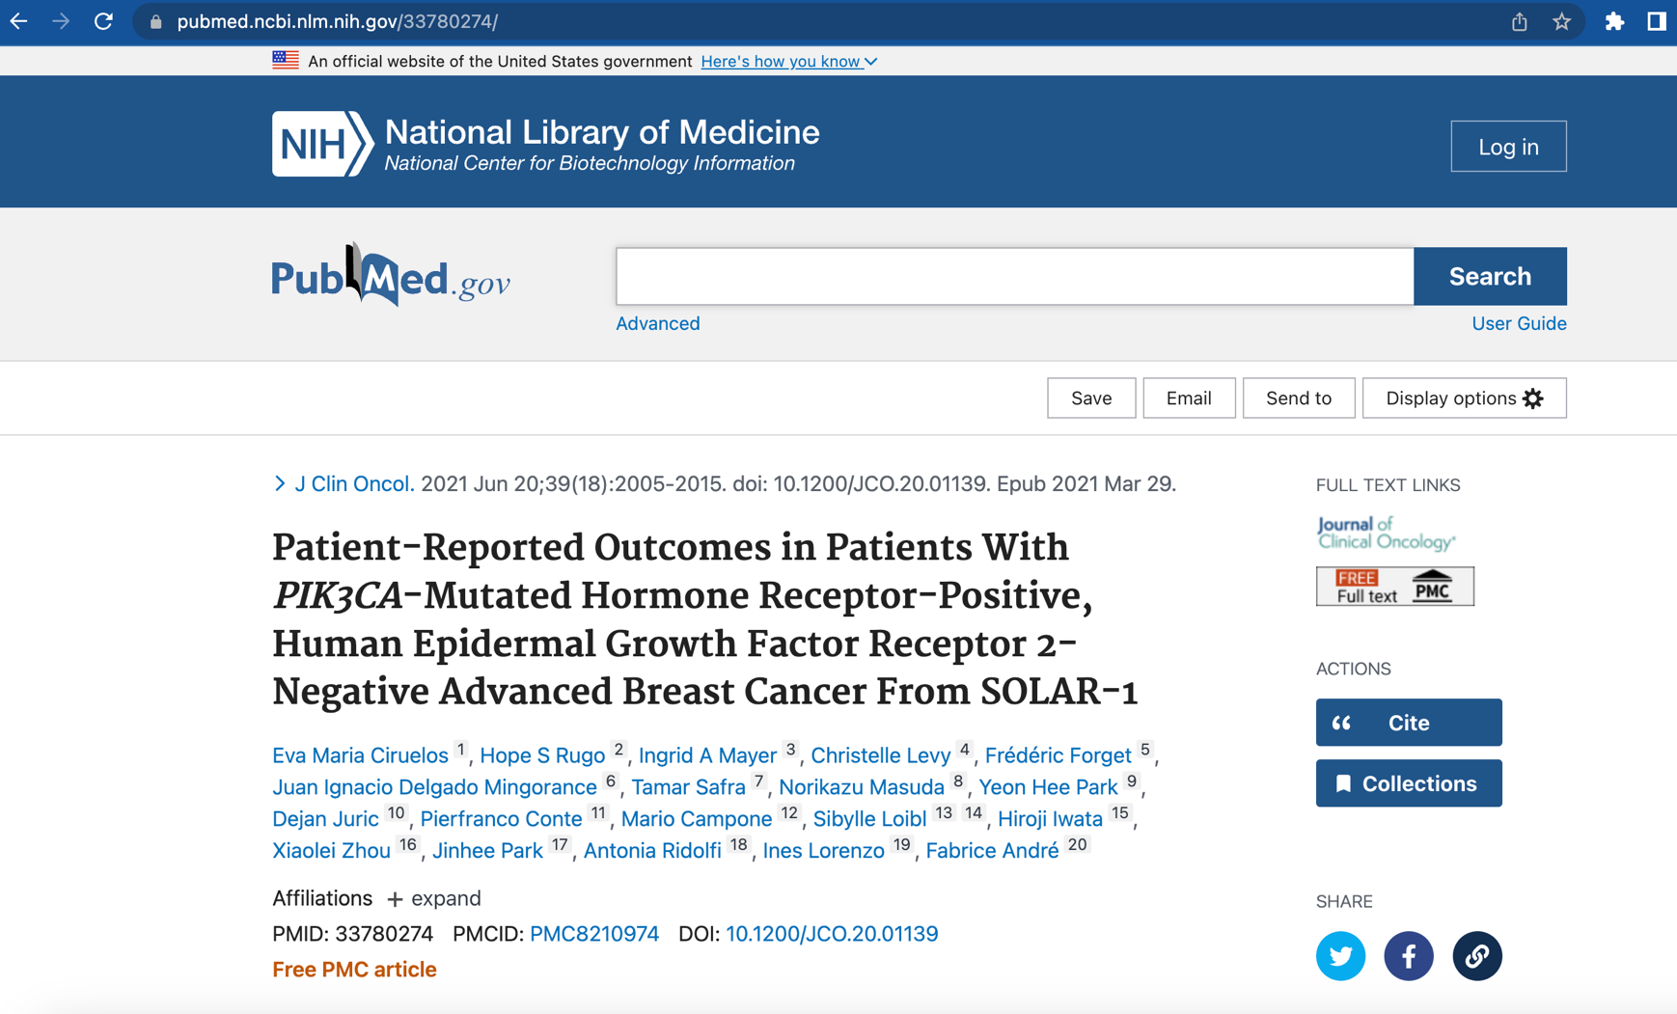
Starting on the PubMed page of interest, click the Cite button

Slide 3
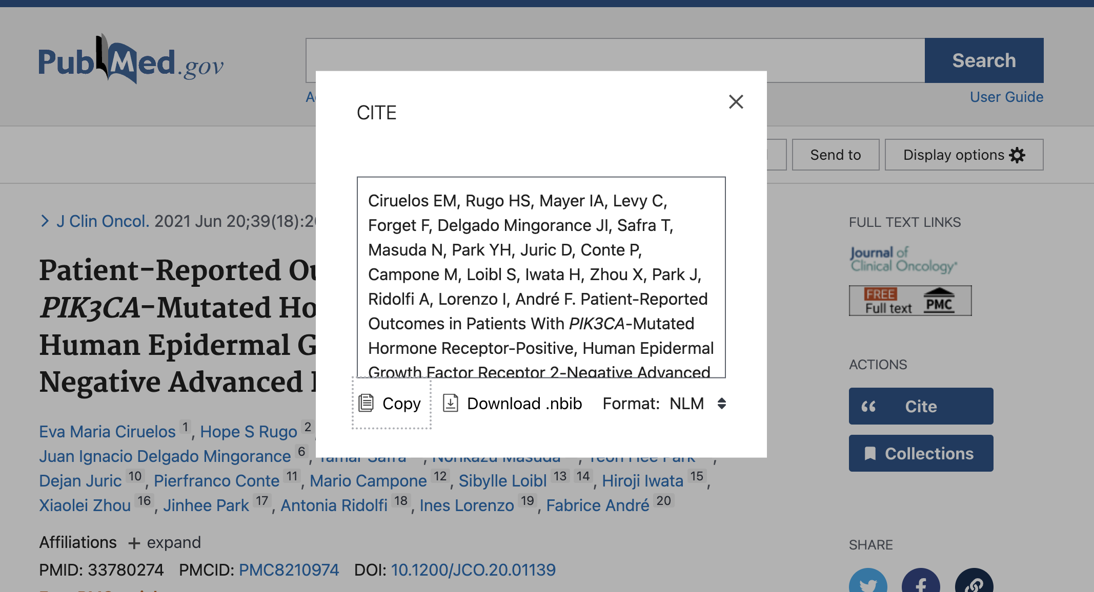
A white box should pop up in the middle of the page.

Slide 4
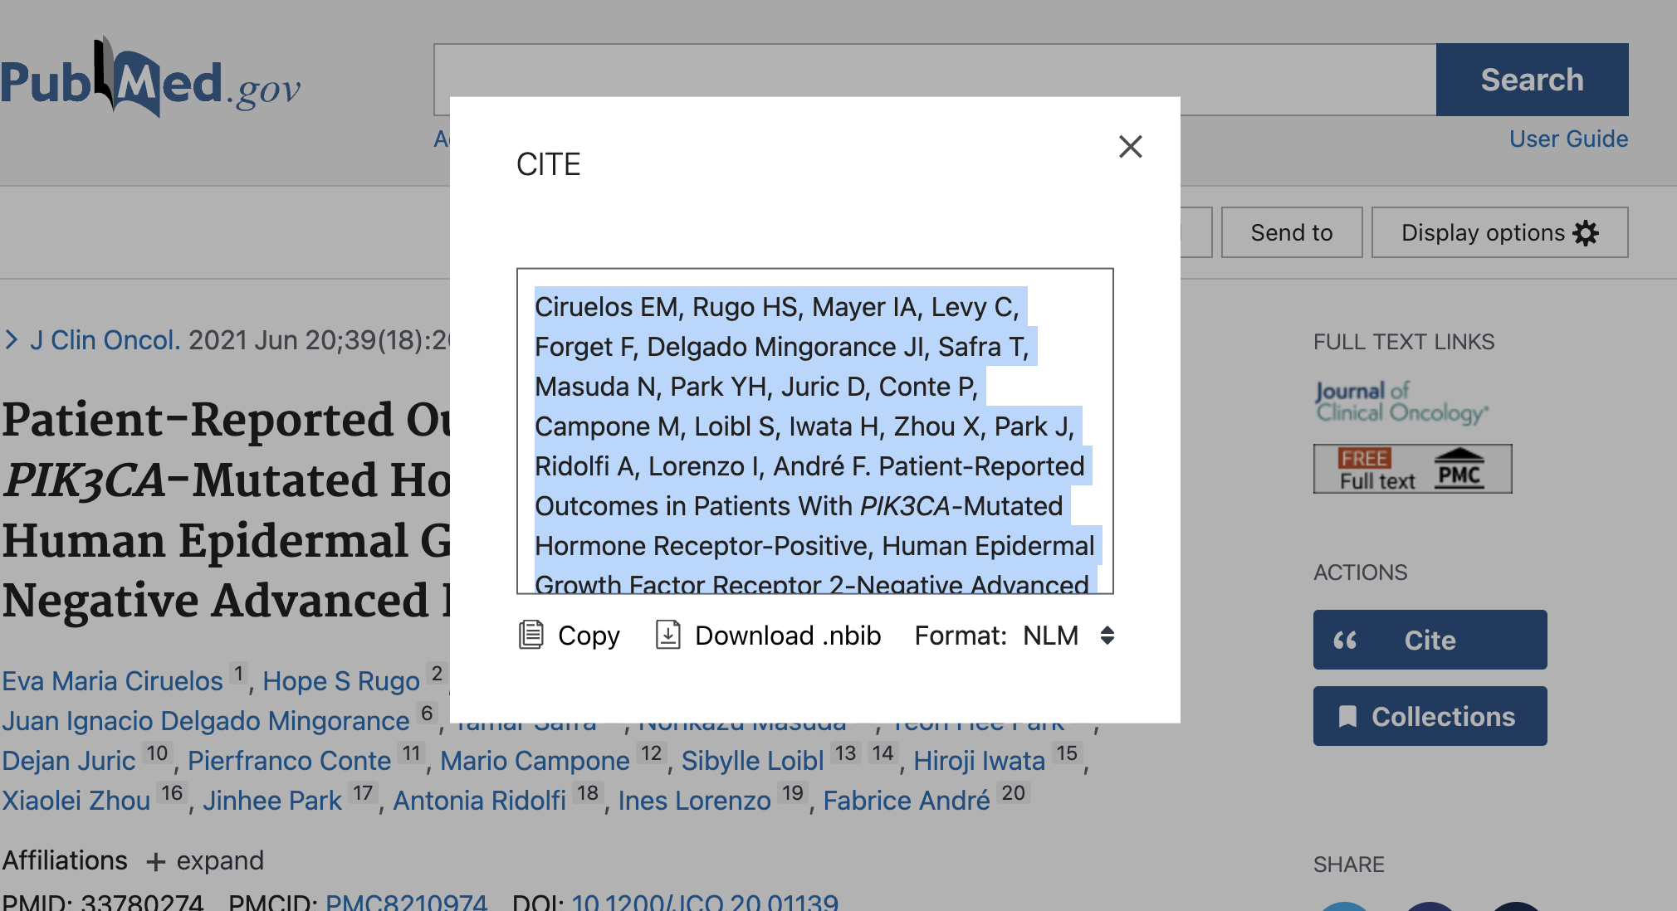
Triple-click on the interior of the citation box, then CMD+C to copy

Slide 5
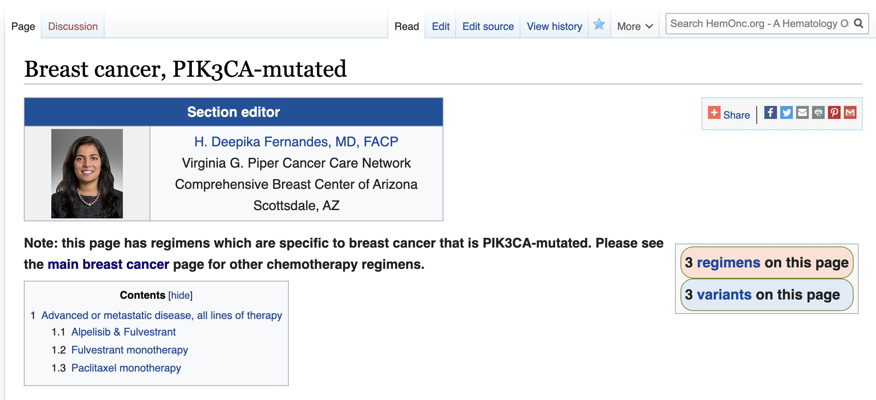
In a separate browser window or tab, navigate to the HemOnc.org page of interest, and click on the “Edit source” at the top of the page.

Slide 6
Alternatively, you can scroll directly to the references section that you wish to edit and click the “edit source” there. Keep in mind that for RCTs the reference will usually show up more than once on a page; you’ll want to update all instances.

Slide 7
Find the reference that needs to be edited.

Slide 8
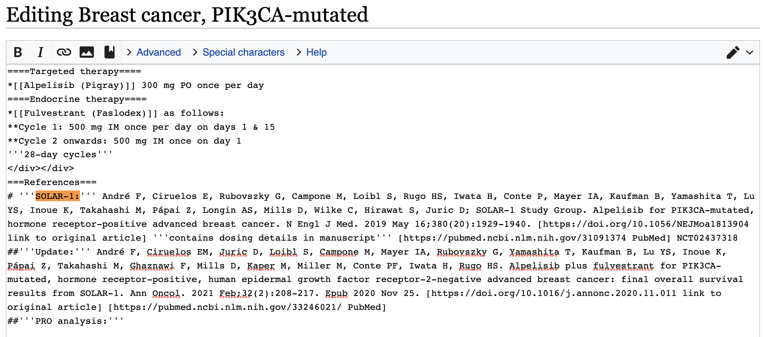
Start a new line using two hashtags, and a description of the type of update, as shown. In this example, the update is a PRO analysis. References need to be in chronologic order based on their earliest date of publication (epub, usually). In the example the new reference goes last, but sometimes it might belong in the middle. Subsequent steps will be shown as raw text.

Slide 9
Starting the reference
##'''PRO analysis:''' Ciruelos EM, Rugo HS, Mayer IA, Levy C, Forget F, Delgado Mingorance JI, Safra T, Masuda N, Park YH, Juric D, Conte P, Campone M, Loibl S, Iwata H, Zhou X, Park J, Ridolfi A, Lorenzo I, André F. Patient-Reported Outcomes in Patients With PIK3CA-Mutated Hormone Receptor-Positive, Human Epidermal Growth Factor Receptor 2-Negative Advanced Breast Cancer From SOLAR-1. J Clin Oncol. 2021 Jun 20;39(18):2005-2015. doi: 10.1200/JCO.20.01139. Epub 2021 Mar 29. PMID: 33780274; PMCID: PMC8210974.
Copy in the text from PubMed using CMD+V.

Slide 10
Remove decorations
##'''PRO analysis:''' Ciruelos EM, Rugo HS, Mayer IA, Levy C, Forget F, Delgado Mingorance JI, Safra T, Masuda N, Park YH, Juric D, Conte P, Campone M, Loibl S, Iwata H, Zhou X, Park J, Ridolfi A, Lorenzo I, André F. Patient-Reported Outcomes in Patients With PIK3CA-Mutated Hormone Receptor-Positive, Human Epidermal Growth Factor Receptor 2-Negative Advanced Breast Cancer From SOLAR-1. J Clin Oncol. 2021 Jun 20;39(18):2005-2015. doi: 10.1200/JCO.20.01139. Epub 2021 Mar 29. PMID: 33780274; PMCID: PMC8210974.
Delete the doi: and the PMID: and PMCID: sections; we’re going to add these back in a slightly different format.

Slide 11
##'''PRO analysis:''' Ciruelos EM, Rugo HS, Mayer IA, Levy C, Forget F, Delgado Mingorance JI, Safra T, Masuda N, Park YH, Juric D, Conte P, Campone M, Loibl S, Iwata H, Zhou X, Park J, Ridolfi A, Lorenzo I, André F. Patient-Reported Outcomes in Patients With PIK3CA-Mutated Hormone Receptor-Positive, Human Epidermal Growth Factor Receptor 2-Negative Advanced Breast Cancer From SOLAR-1. J Clin Oncol. 2021 Jun 20;39(18):2005-2015. Epub 2021 Mar 29.
These sections are deleted now.

Slide 12
Go back to the PubMed window and close the popup box.

Slide 13
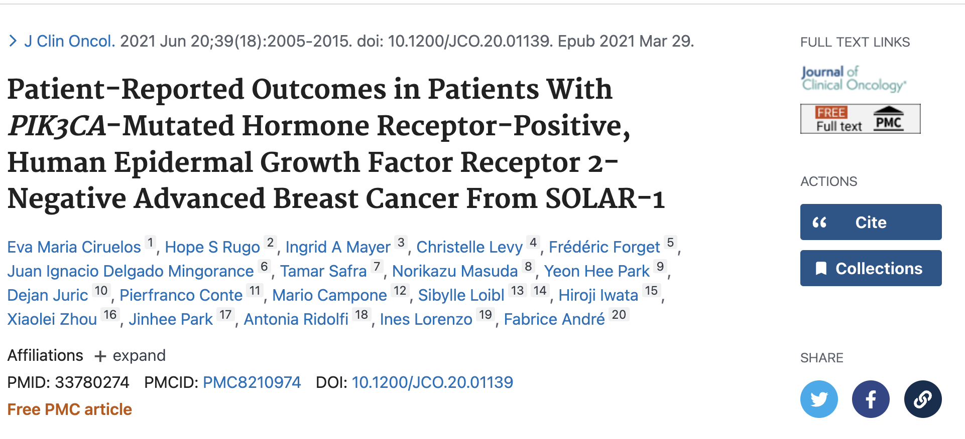
Just beneath the list of authors, find the link after DOI:

Slide 14
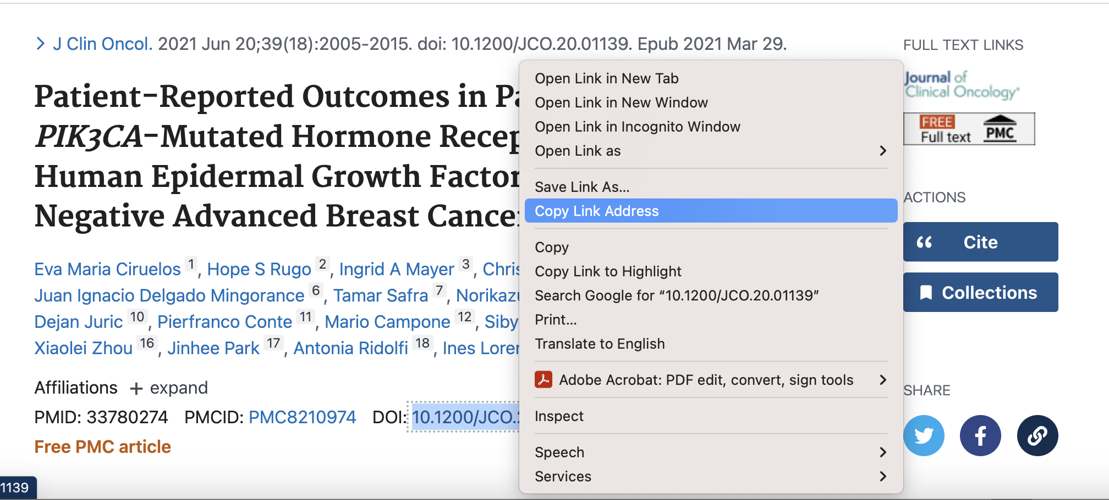
Click on the link following DOI: using CTRL+click. You should see the popup menu shown; select “Copy Link Address”.

Slide 15
Adding the link to original article
##'''PRO analysis:''' Ciruelos EM, Rugo HS, Mayer IA, Levy C, Forget F, Delgado Mingorance JI, Safra T, Masuda N, Park YH, Juric D, Conte P, Campone M, Loibl S, Iwata H, Zhou X, Park J, Ridolfi A, Lorenzo I, André F. Patient-Reported Outcomes in Patients With PIK3CA-Mutated Hormone Receptor-Positive, Human Epidermal Growth Factor Receptor 2-Negative Advanced Breast Cancer From SOLAR-1. J Clin Oncol. 2021 Jun 20;39(18):2005-2015. Epub 2021 Mar 29. [https://doi.org/10.1200/jco.20.01139 link to original article]
Back to the HemOnc.org editor. At the end of the line, type a left bracket, then use CMD+V to copy in the link, then type a space and “link to original article” and close with a right bracket.

Slide 16
Back to PubMed. Look to left of DOI: for a link following PMCID:
If you don’t see anything here, skip the next 2 slides.

Slide 17
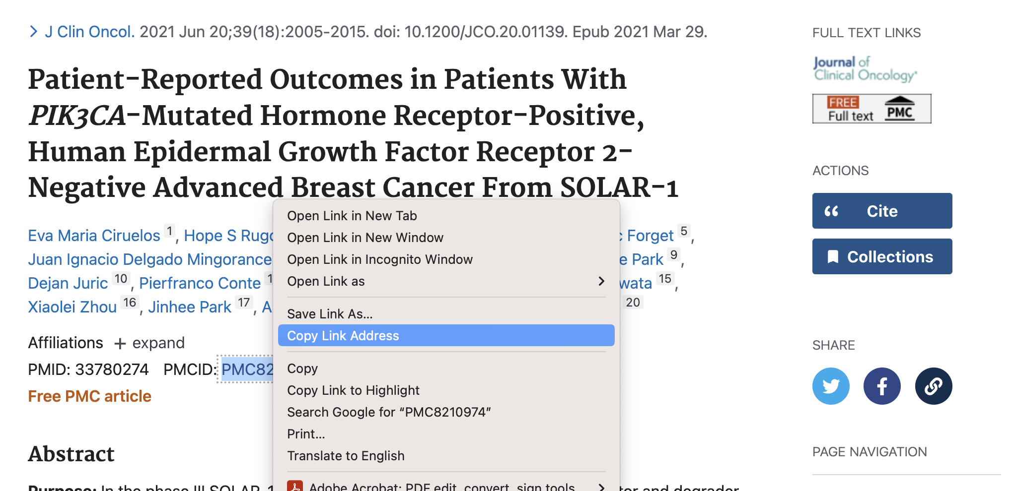
If you see a PMCID, repeat the process: click on the link following PMCID: using CTRL+click. You should see the popup menu shown; select “Copy Link Address”.

Slide 18
Adding the link to PMC article (if applicable)
##'''PRO analysis:''' Ciruelos EM, Rugo HS, Mayer IA, Levy C, Forget F, Delgado Mingorance JI, Safra T, Masuda N, Park YH, Juric D, Conte P, Campone M, Loibl S, Iwata H, Zhou X, Park J, Ridolfi A, Lorenzo I, André F. Patient-Reported Outcomes in Patients With PIK3CA-Mutated Hormone Receptor-Positive, Human Epidermal Growth Factor Receptor 2-Negative Advanced Breast Cancer From SOLAR-1. J Clin Oncol. 2021 Jun 20;39(18):2005-2015. Epub 2021 Mar 29. [https://doi.org/10.1200/jco.20.01139 link to original article] [http://www.ncbi.nlm.nih.gov/pmc/articles/pmc8210974/ link to PMC article]
Back to the HemOnc.org editor. At the end of the line, type a left bracket, then use CMD+V to copy in the link, then type a space and “link to PMC article” and close with a right bracket.

Slide 19
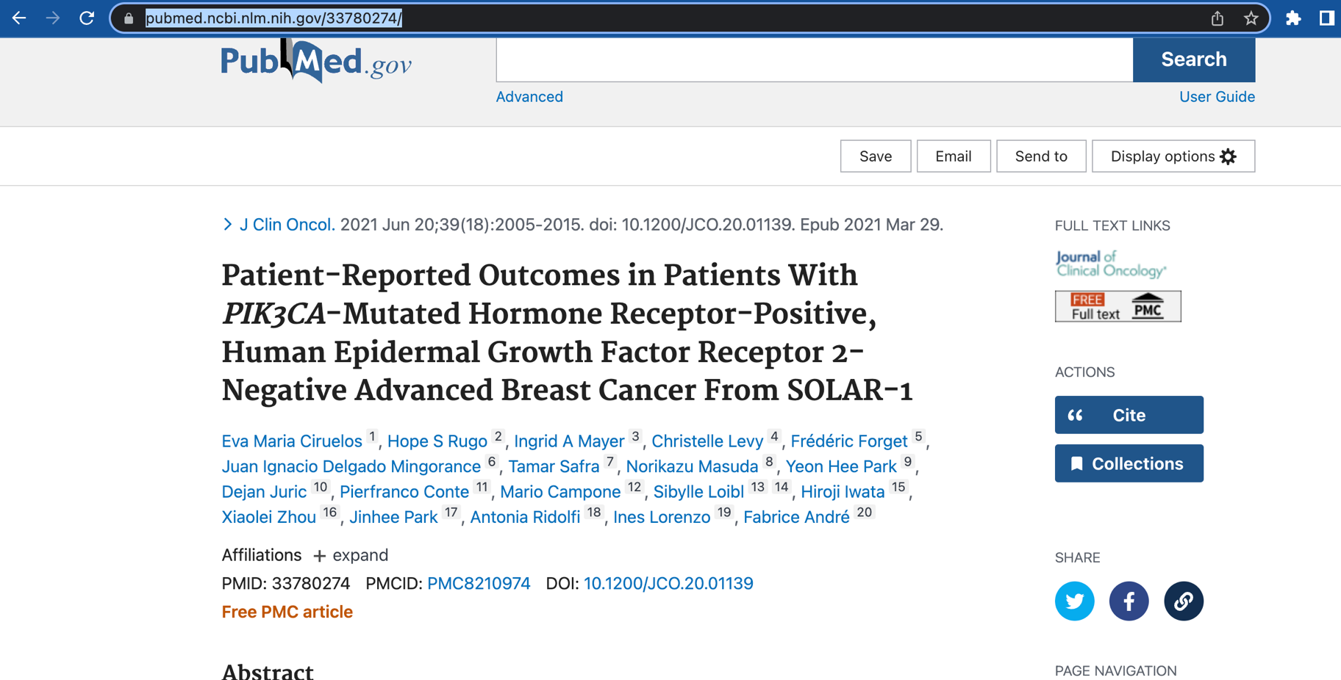
Back to PubMed. For the PubMed link, just go to the browser navigation area and copy the link after clicking here, using CMD+C. You may have to click a few times until the whole URL is highlighted.

Slide 20
Adding the link to PubMed
##'''PRO analysis:''' Ciruelos EM, Rugo HS, Mayer IA, Levy C, Forget F, Delgado Mingorance JI, Safra T, Masuda N, Park YH, Juric D, Conte P, Campone M, Loibl S, Iwata H, Zhou X, Park J, Ridolfi A, Lorenzo I, André F. Patient-Reported Outcomes in Patients With PIK3CA-Mutated Hormone Receptor-Positive, Human Epidermal Growth Factor Receptor 2-Negative Advanced Breast Cancer From SOLAR-1. J Clin Oncol. 2021 Jun 20;39(18):2005-2015. Epub 2021 Mar 29. [https://doi.org/10.1200/jco.20.01139 link to original article] [http://www.ncbi.nlm.nih.gov/pmc/articles/pmc8210974/ link to PMC article] [https://pubmed.ncbi.nlm.nih.gov/33780274/ PubMed]
Back to the HemOnc.org editor. At the end of the line, type a left bracket, then use CMD+V to copy in the link, then type a space and “PubMed” and close with a right bracket.

Slide 21
Final format
##'''PRO analysis:''' Ciruelos EM, Rugo HS, Mayer IA, Levy C, Forget F, Delgado Mingorance JI, Safra T, Masuda N, Park YH, Juric D, Conte P, Campone M, Loibl S, Iwata H, Zhou X, Park J, Ridolfi A, Lorenzo I, André F. Patient-Reported Outcomes in Patients With PIK3CA-Mutated Hormone Receptor-Positive, Human Epidermal Growth Factor Receptor 2-Negative Advanced Breast Cancer From SOLAR-1. J Clin Oncol. 2021 Jun 20;39(18):2005-2015. Epub 2021 Mar 29. [https://doi.org/10.1200/jco.20.01139 link to original article] [http://www.ncbi.nlm.nih.gov/pmc/articles/pmc8210974/ link to PMC article] [https://pubmed.ncbi.nlm.nih.gov/33780274/ PubMed]
That’s it! If the trial shows up in more than one place on the page, just clone the reference using CMD+C and make a copy in the correct place. Just one last step – saving the changes!

Slide 22
Scroll to the bottom of the page and you will see a gray box as shown above. I don’t bother to fill the “Summary:” for this sort of change, although you can if you want to. For me, the “This is a minor edit” is checked by default; check this if not too much trouble, but it isn’t necessary. If you want to be notified of subsequent changes to the page, check “Watch this page”. Finally, click the “Save changes” button, circled in red above.
TL;DR: click the Save changes button

Slide 23
Notes
For overall efficacy updates, we use the generic “Update”; other standard options include “Subgroup analysis”; “HRQoL analysis”; and “PRO analysis”. Try not to use non-standard options.
If the update is about multiple trials, add the word “Pooled” and use sentence case, e.g., “Pooled update”; “Pooled subgroup analysis”
The format of the start of the update must be consistent, or the parser will not work:
##'''Xyz:'''
Don’t forget the brackets for article/PMC/PubMed, or the links won’t work.
This works fastest if you have two screens, one with the HemOnc.org page, and one with PubMed. Otherwise, you’ll need to go back and forth between tabs several times.

